Slide 1




17th International Conference on Computational Collective Intelligence
An Explainable AI-Based Breast Cancer Classification Combining Rule Sets and Deep Neural Networks
Ho-Dat TRAN, Thuong-Cang PHAN,
Vinh-Phong NGUYEN, Anh-Cang PHAN
Ho Chi Minh, Nov-12-2025
Notes:
Good morning everyone, I’m very please present my research , Breast cancer classification based on fuzzy rules and deep learning techniques

Slide 2
CONTENT
1. Introduction
2. Related works
3. Proposed method
5. Conclusion
4. Experimental results
Notes:
The following is the content for my presentation. Section 2 introduces and summarizes related work. In Sections 3, we provide a detailed description of the main components of our approach. We describe the experimental setup to validate our approach along with a discussion of the results in Section 4. Finally, we conclude with a summary of our findings and comment on possible future directions in Section 5.

Slide 3

1. Introduction
Challenges
Breast cancer is one of the most common cancers affecting women worldwide.
Early detection and accurate staging of breast cancer can significantly improve survival rates and quality of life for patients.
Fig 1. Images on 2 views a) RMLO b) LMLO c) RCC d) LCC with the mass location localized in images a) and c)
Notes:
As we know, cancer is one of the most common diseases in the world and takes the lives of millions of people every year. Breast cancer is one of the most common cancers affecting women worldwide.
Early detection and accurate staging of breast cancer can significantly improve survival rates and quality of life for patients..Figure 1 is an image of a breast with a mass of unusual brightness.

Slide 4
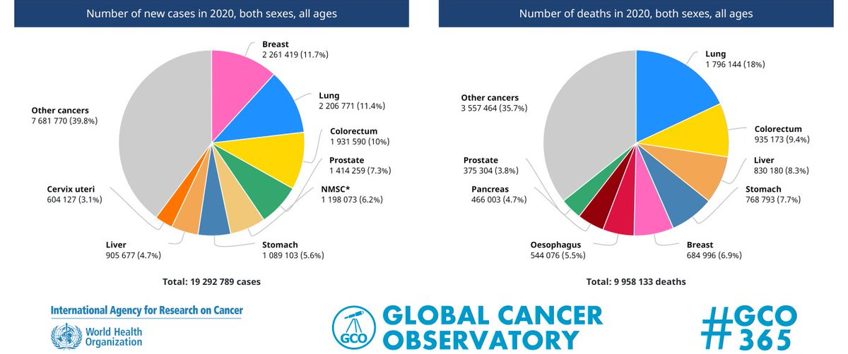
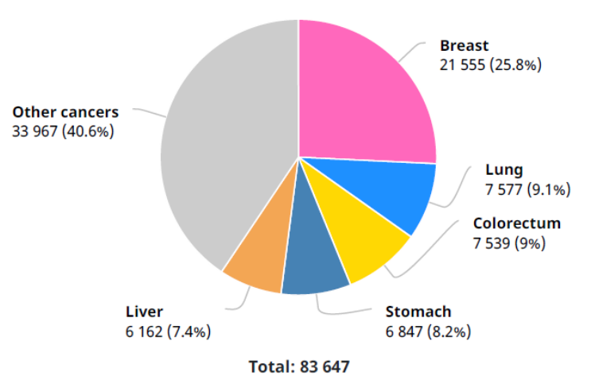
1. Introduction
Challenges
Breast cancer (BC) predicted has affected 2.3 million women worldwide in 2020, with 685,000 fatalities. Breast cancer had been detected in 7.8 million females in the previous five years as of 2020, making it the most common cancer on the planet. It causes more disability adjusted life years (DALYs) in women worldwidethan any other form of cancer[1].
The number of new cancer cases in 2020 among women in Vietnam
Fig 2. Global Cancer statistics
Notes:
According to GLOBOCAN statistics in 2020, the world is estimated to have about 19.3 million cases and 10 million deaths caused by cancer. Of which, breast cancer in women is 2.26 million cases, accounting for 11.7%.
In Vietnam, breast cancer is the leading disease among women. Because of the prevalence of this disease, there are currently many related studies being conducted with the goal of detecting and classifying breast cancer using many different methods, the most popular of which is the application of information technology in detecting and classifying abnormalities on mammograms.
Because of its popularity, there have been many research projects related to this disease in recent times.
Theo số liệu thống kê của GLOBOCAN trong năm 2020 cả thế giới ước tính có khoảng 19.3 triệu ca mắc và 10 triệu ca tử vong do ung thư gây nên. Trong đó, ung thư vú ở phụ nữ là 2.26 triệu ca chiếm 11.7%.

Slide 5



1. Introduction
Targets:
Classification and segmentation on mammograms based on deep learning techniques
Install and experiment with the model, test, evaluate and compare the results.
Using FIS and XAI to enhance classification efficiency and improve the interpretation of outputs from machine learning models
Notes:
Some of the key points our research covers are:
To achieve the above content, we briefly reviewed the research works of previous authors.

Slide 6
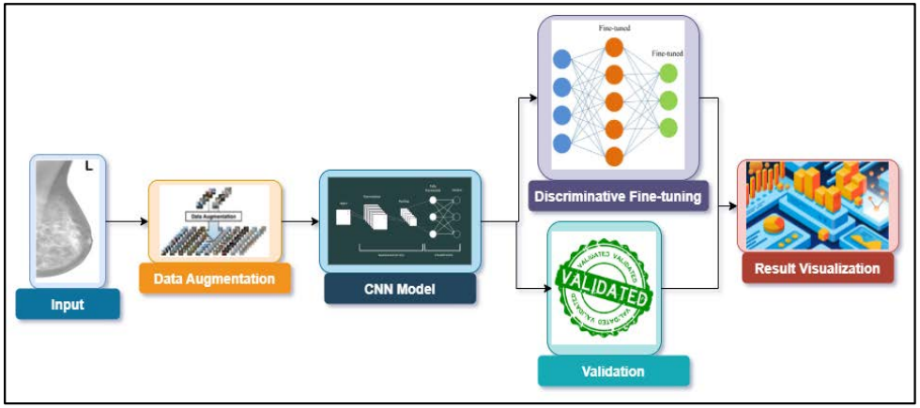
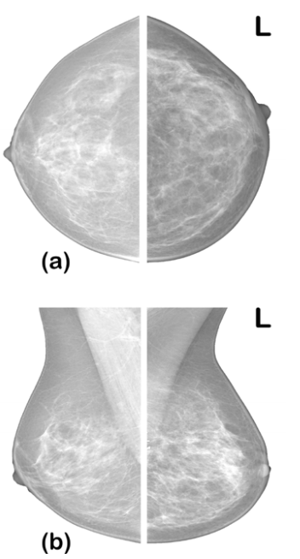
2. Related works
- Architecture network: AlexNet, VGG, SquezzeNet, ResNet, DenseNet
- Dataset: CBIS-DDSM
- Accuracy: 99.8%
Fig 3. Performance Evaluation of Deep Learning Models on Mammogram Classification Using Small Dataset [3]
Notes:
Adedigba và cộng sự y một phương pháp huấn luyện mô hình học sâu để chẩn đoán BC. Chúng tôi đã phát triển một phương pháp tinh chỉnh phân biệt, fine-tuning cho mỗi lớp của CNN sâu. Ngoài ra, mô hình được huấn luyện bằng phương pháp huấn luyện độ chính xác hỗn hợp để giảm bớt nhu cầu tính toán khi huấn luyện các mô hình học sâu. Cuối cùng, chúng tôi trình bày các phương pháp tăng cường dữ liệu cho chụp nhũ ảnh.

Slide 7
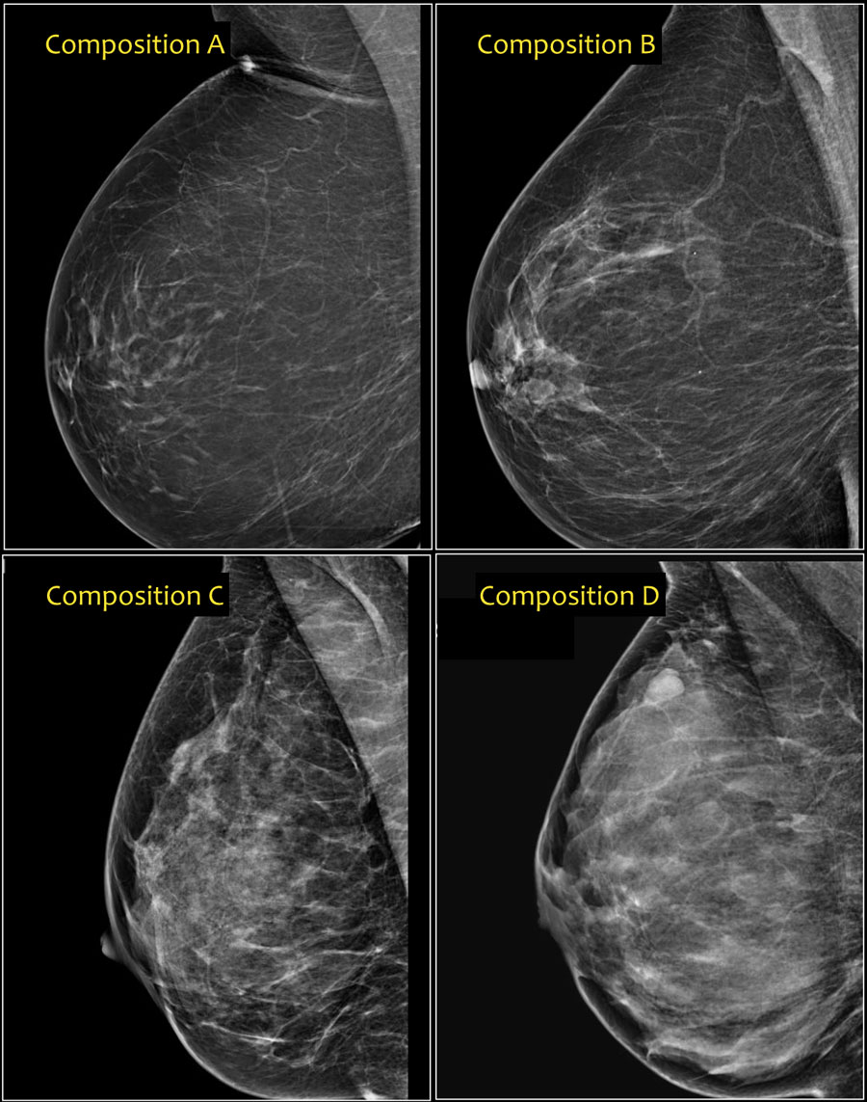
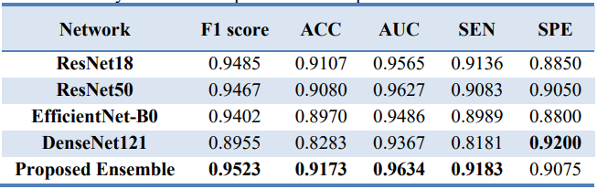
2. Related works
- Mammographic density classification (A, B, C, D) using a combined model (ResNet18, ResNet50, EfficientNet-B0, DenseNet121)
- Dataset: VinDr-Mammo
- Accuracy: AUC: 0.963, F1-score: 0.952 (Soft voting)
Fig 4. Attention-Enhanced Deep Learning Ensemble for Breast Density Classification in Mammography
Notes:
Attention-Enhanced Deep Learning Ensemble for Breast Density Classification in Mammography - Peyman Sharifian

Slide 8
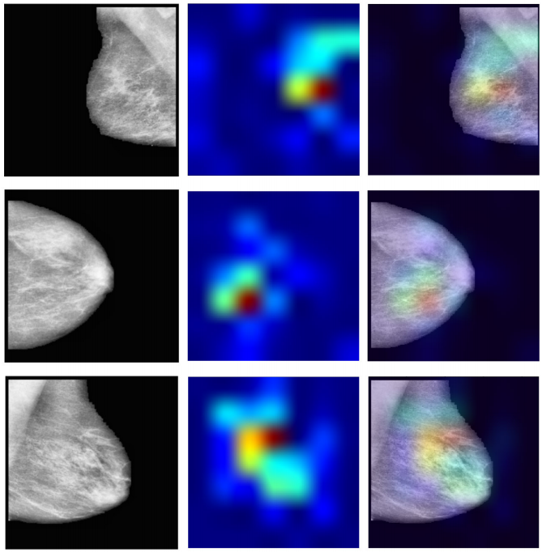
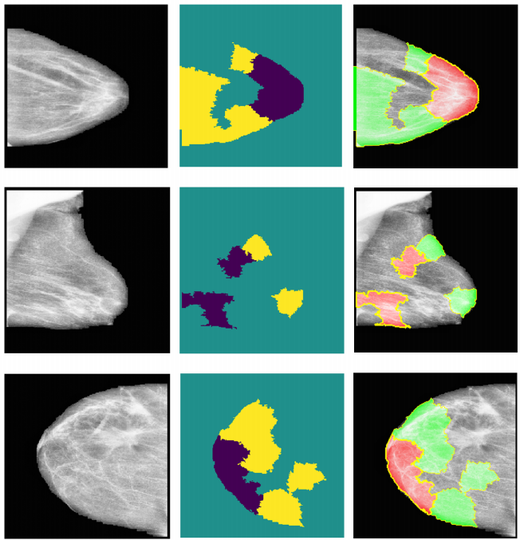
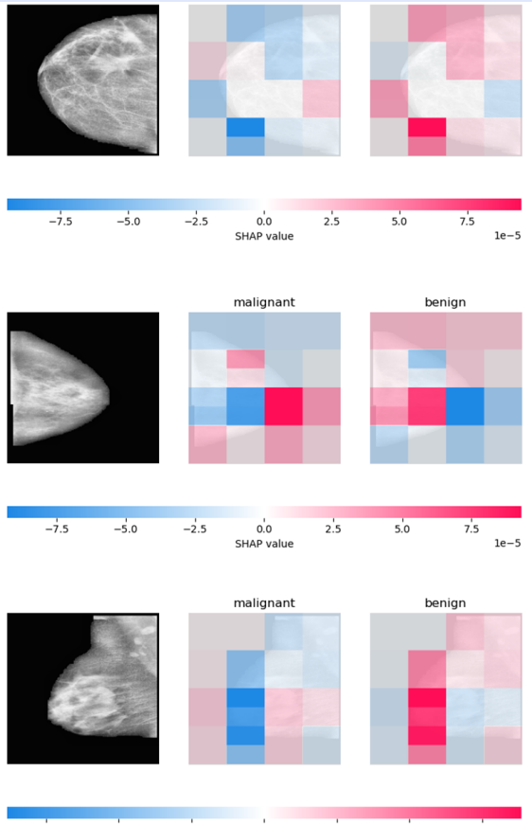
2. Related works
Model: VGG16, InceptionV3, Res-Net18
Dataset: CIBS-DDSM
Accuracy: 76%
Fig 5. Enhancing Breast Cancer Diagnosis in Mammography: Evaluation and Integration of Convolutional Neural Networks and Explainable AI (Ahmed et al. 2024)
Notes:
A focal point of our study is the evaluation of XAI’s effectiveness in
interpreting model predictions, highlighted by utilising the Hausdorff measure to assess the align-ment between AI-generated explanations and expert annotations quantitatively.

Slide 9
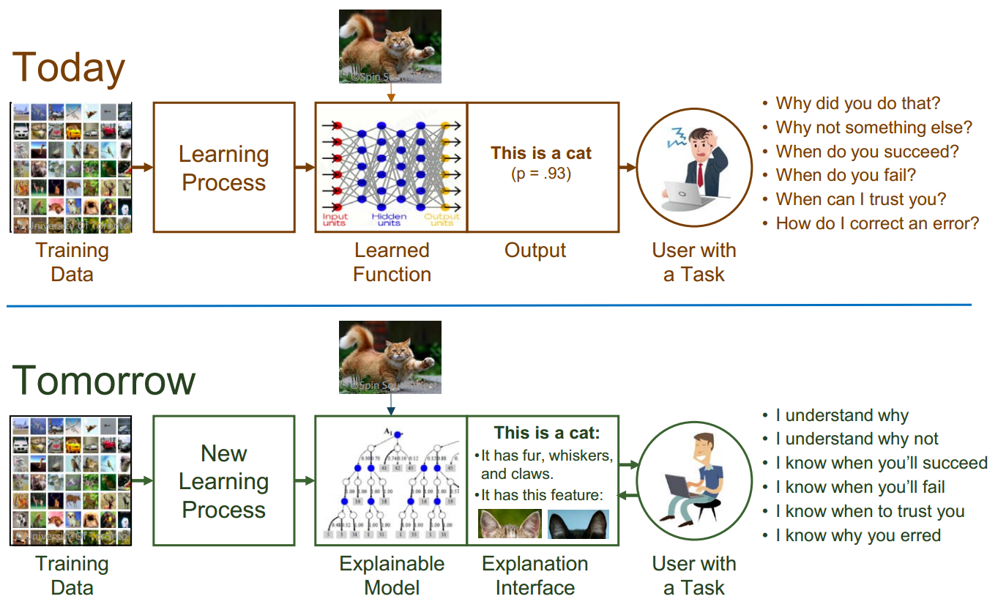
2. Related works
Explainable AI – What Are We Trying To Do?
Fig 6a. Explainable Artificial Intelligence (XAI) - David Gunning
Notes:
Attention-Enhanced Deep Learning Ensemble for Breast Density Classification in Mammography - Peyman Sharifian

Slide 10
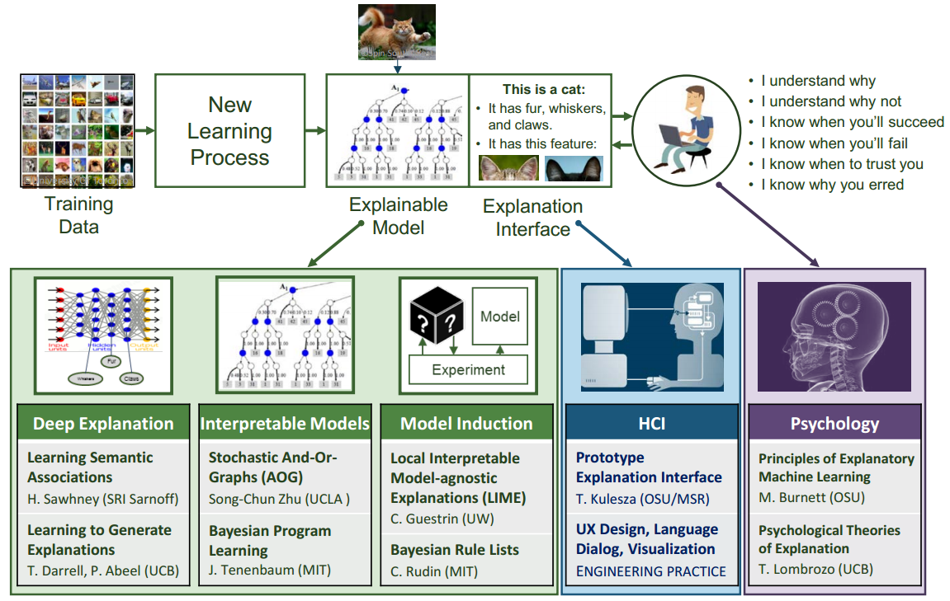
2. Related works
Fig 6b. Explainable Artificial Intelligence (XAI) - David Gunning

Slide 11
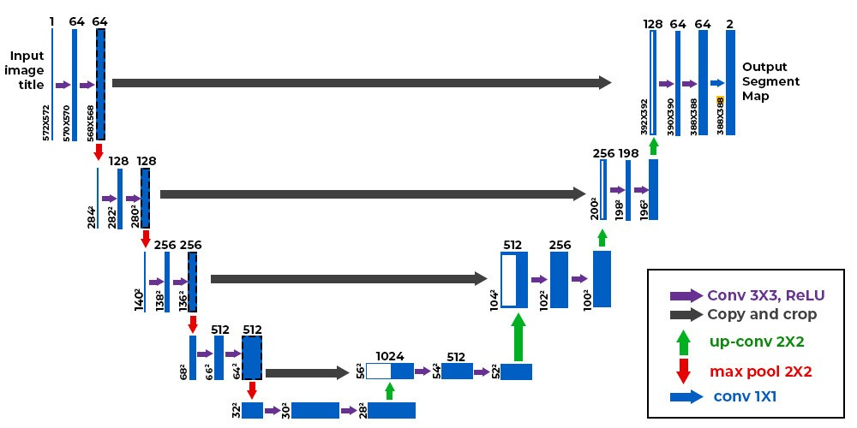
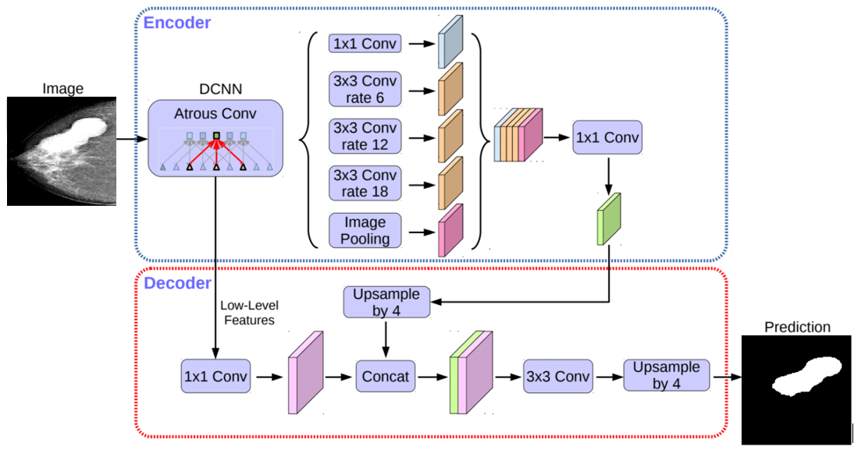
2. Related works
Deep learning:
Fig 7. U-Net architecture
Fig 8. DeepLabV3+ architecture

Slide 12
2. Related works
Algorithm 1 JRIP Algorithm
Require: Training dataset D with categories {C₁, C₂, …, Cₘ}
Ensure: Learned rule collection ℛ
1: Order the categories {C₁, C₂, …, Cₘ} in ascending order of sample counts.
2: Initialize ℛ ← ∅.
3: for each category Cⱼ in the ordered list do
4: repeat
5: Construct a provisional rule ρⱼ that maximally fits the samples of Cⱼ.
6: Refine ρⱼ through pruning and optimization steps.
7: Insert ρⱼ into ℛ.
8: Eliminate all instances of D that are covered by ρⱼ.
9: until no instances of Cⱼ remain uncovered
10: end for
11: Define a default rule to assign labels for any instances not captured by ℛ.
12: return ℛ as the final induced rule base.
Notes:
The JRIP algorithm is a rule-based classification method that builds an interpretable set of rules from training data. It starts by ordering the categories based on their sample sizes, then iteratively constructs, refines, and adds rules that best fit each category. After each rule is created, the covered instances are removed from the dataset. This process repeats until all samples are covered. Finally, a default rule is added to handle any remaining instances. The result is a compact and optimized rule set that serves as the final classification model.

Slide 13
2. Related works
Algorithm 2 PART Algorithm
Require: Training dataset 𝒟
Ensure: Derived rule base ℛ
1: Start with an empty rule collection: ℛ ← ∅
2: Define 𝒟_{uncovered} ← 𝒟 to represent instances not yet explained
3: while 𝒟_{uncovered} ≠ ∅ do
4: Induce a partial decision tree using 𝒟_{uncovered}
5: Select the most discriminative branch to form a provisional rule φ
6: Append φ into ℛ
7: Remove from 𝒟_{uncovered} all samples covered by φ
8: Discard the remainder of the partial tree
9: end while
10: return ℛ as the final constructed rule base
Notes:
The PART algorithm is a rule-based learning method that generates a set of classification rules without global optimization. It begins with an empty rule set and uses all training instances as uncovered data. In each iteration, the algorithm builds a partial decision tree from the remaining uncovered instances and selects the most discriminative branch to form a provisional rule. This rule is then added to the rule set, and all instances covered by it are removed from the uncovered data. The rest of the partial tree is discarded, and the process repeats until all instances are covered. Finally, the algorithm outputs the complete set of rules as the final rule base.

Slide 14
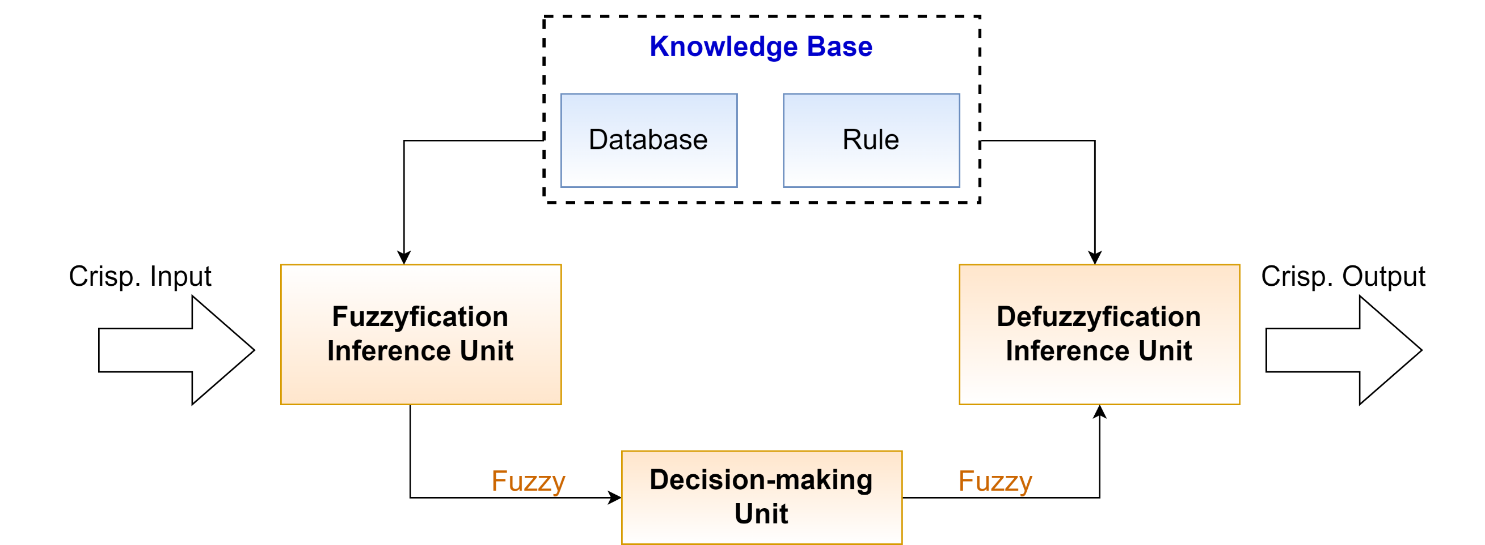

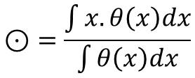

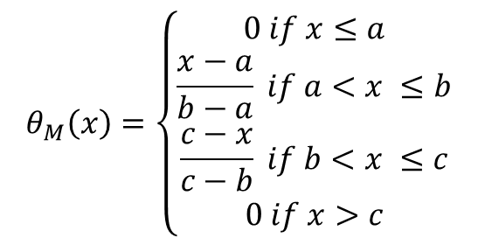
2. Related works
Fig 9. Fuzzy inference system (FIS)[12]
$$θ_{M}\left(x\right)=\left\{\begin{aligned}0 if x≤a \\ \frac{x−a}{b−a} if a<x ≤b \\ \frac{c−x}{c−b} if b<x ≤c \\ 0 if x>c\end{aligned}\right.$$
$$\text{⊙}=\frac{\int{x.θ\left(x\right)dx}}{\int{θ\left(x\right)dx}}$$
$$(1)$$
$$(2)$$
Notes:
Delta
The crisp values of the input are converted into fuzzy values with the assistance of fuzzy membership functions.
In the context of a fuzzy set M, the membership function is defined by the expression θM(x), where θM(x) ∈ [0, 1] denotes the degree of membership of x to the fuzzy set M. A graphical representation of each membership function is presented in order to highlight the degree to which each input contributes to a set. A mathematically straightforward approach is provided by the triangular membership function, which is utilized in this study. It is defined by three parameters {a, b, c}, where the membership function θM(x) for each value x isspecified in Eq.1. The values of these parameters are taken from the knowledge of specialists.
A fuzzy inference is performed during the second phase, during which the system processes the values that are input. Concluding statements are generated by the fuzzy inference system by employing IF-THEN language rules derived from a knowledge base. For the purpose of influencing the fuzzy output sets and the conclusions that are ultimately drawn, these rules use input membership values as weights. During the last phase, the fuzzy findings are converted back into exact and crisp values by the process of defuzzification. The method of defuzzification involves taking a weighted average of the values of x, where the weights are the membership function values denoted by θ(x).

Slide 15
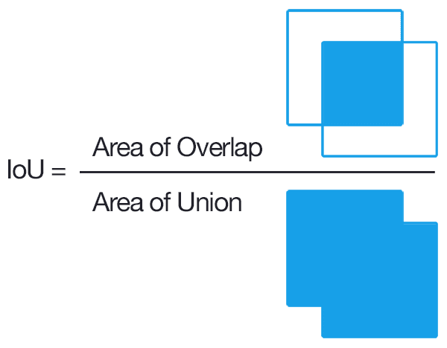

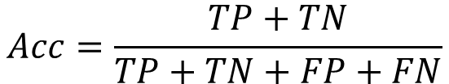
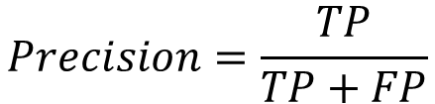

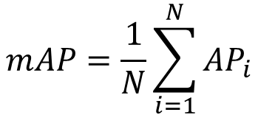




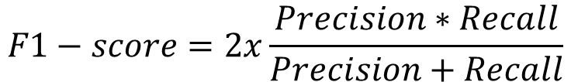


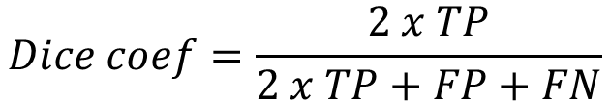
2. Related works
Evaluation metrics:
$$Precision=\frac{TP}{TP+FP}$$
$$F1−score=2x\frac{Precision∗Recall}{Precision+Recall}$$
$$(3)$$
$$(4)$$
$$Acc=\frac{TP+TN}{TP+TN+FP+FN}$$
$$mAP=\frac{1}{N}\sum_{i=1}^{N}{AP_{i}}$$
$$(5)$$
$$(6)$$
$$Dice coef=\frac{2 x TP}{2 x TP+FP+FN}$$
$$(7)$$
$$(8)$$
$$Dice Loss=1 −Dice coef$$
$$(9)$$
Notes:
Some metrics we use in evaluating proposed models
where u_{i} is the ground truth at pixel 𝑖, $\hat{u_{i}}$ is the predicted value at pixel 𝑖 out of total number of pixels n.
In which, wi: weight of the ith model; 1{mi(x)=c} : equal to 1 if model i chooses
class c, otherwise equal to 0.

Slide 16
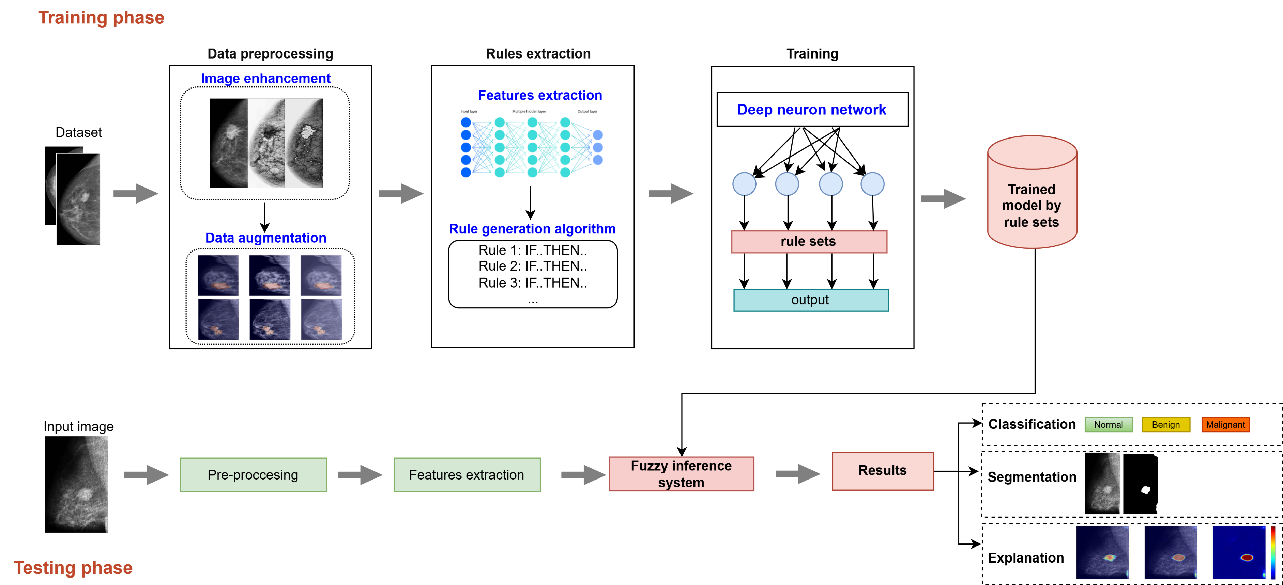
3. Proposed Method
Fig 10. The proposed model for breast cancer segmentation and classification

Slide 17
3. Proposed Method
Data preprocessing: Each input image is resized to 224x224 pixels, saved in .jpg format, and normalized prior to training. The input data is preprocessed using a number of techniques such as cropping, image enhancement, and data augmentation (flip, rotate, zoom, etc.).
Feature Extraction and Rule Generation: After pre-processing, the images are fed into deep learning models to extract relevant features. These features are then transformed into rule sets through the application of the JRIP and PART algorithms
- Classification and Interpretation with FIS: The system is trained using features obtained from U-Net and DeepLabv3+ models, which are converted into fuzzy rules. These rules associate fuzzy inputs with their corresponding class labels and define the membership functions for each feature. During inference, features from unseen images are fuzzified and processed through the FIS to generate fuzzy outputs. A defuzzification step is then performed using the weighted average method, producing crisp classification results.
- Explanation of Grad-CAM Heatmap: The heatmap intensity ranges from 0.0 (Blue regions) to 1.0 (Red regions). Intermediate values from 0.0 to 1.0 (shades of green to yellow) represent varying levels of attention or suspicion for potential abnormalities.
Notes:
The classification stage employs a Fuzzy Inference System (FIS). The system is trained using features obtained from U-Net and DeepLabv3+ models, which are converted into fuzzy rules. These rules associate fuzzy inputs with their corresponding class labels and define the membership functions for each feature. During inference, features from unseen images are fuzzified and processed through the FIS to generate fuzzy outputs. A defuzzification step is then performed using the weighted average method, producing crisp classification results. Finally, these results are matched with the trained classes, enabling accurate categorization of the test images. This pipeline ensures robust classification while retaining interpretability through fuzzy reasoning.
Explanation of Grad-CAM Heatmap: The Grad-CAM heatmap visualizes the model’s attention regions when making predictions. The heatmap intensity ranges from 0.0 (Blue regions) to 1.0 (Red regions). Intermediate values from 0.0 to 1.0 (shades of green to yellow) represent varying levels of attention or suspicion for potential abnormalities. The color gradient helps identify areas of interest, assisting physicians in further examination.

Slide 18
3. Proposed Method
Algorithm 3 Classification using Fuzzy Inference System (FIS) with Grad-CAM Integration
Input: Trained model T, feature vector of the test sample X_{test}, FIS
Output: Predicted label C
1: Standardize X_{test} so that all attributes are comparable in scale.
2: Create an empty container Fuzzy_values to store membership responses.
3: for each component x_{i} in X_{test} do
4: for each fuzzy set A_{k} defined in FIS do
5: Evaluate the degree of membership θ_{Mk}(x_{i}) via the membership function (Eq. 1).
6: Store θ_{Mk}(x_{i}) into Fuzzy_values.
7: end for
8: end for
9: Initialize Rule_{activations} as an empty list.
10: for every rule R encoded in FIS do
11: Derive the firing strength of R using Fuzzy_values with fuzzy operators.
12: Record this strength into Rule_{activations}
13: end for
14: Combine the elements in Rule_{activations} to obtain crisp decision scores Sc for all classes.
15: Translate Sc into final numerical outputs using ⊙ defuzzification method (Eq. 2).
16: Execute Grad-CAM on T to generate heatmaps highlighting regions that influenced the prediction.
17: Assign the output label as C ← arg max Sc.
18: return C
Notes:
The algorithm classifies a test sample using a Fuzzy Inference System (FIS) with Grad-CAM integration.
It standardizes input features, computes fuzzy membership degrees for each attribute and fuzzy set, derives rule firing strengths, aggregates them into crisp class scores via defuzzification, generates Grad-CAM heatmaps to highlight influential input regions, and assigns the class with the highest score as the final prediction.

Slide 19
4. Experimental results
Environment: The system runs in a Python environment on Kaggle, using an Intel Xeon 2.00 GHz processor with 30GB RAM. It also utilizes a graphics processor with a 16GB RAM configuration and the Nvidia Tesla P100 GPU. Tensorflow v1.5 is the library used for network model training.
Dataset: The dataset is compiled from the VinDr dataset, supplemented with data from several hospitals. The number of images we use in the paper includes 6874 for training and the testing dataset include 242 benign, 310 malignant, and 493 normal. The dataset is divided in the ratio of 70:30.
Tab 1: Proposed scenarios and training parameters
Sce. | Model | Epochs | Batch size | Learning rate | Num rules
1 | U-Net | 100 | 32 | 0.0001 | -
2 | U-Net JRIP | 100 | 32 | 0.0001 | 15
3 | U-Net PART | 100 | 32 | 0.0001 | 196
4 | DeepLabv3+ | 100 | 32 | 0.0001 | -
5 | DeepLabv3+ JRIP | 100 | 32 | 0.0001 | 31
6 | DeepLabv3+ PART | 100 | 32 | 0.0001 | 89
Notes:
This dataset is divided into a training dataset and a validation dataset with a ratio of 80% and 20%, respectively. For testing, we build a hypothetical scenario where the students were doing the exam, then recorded a video, and tested it with a number of 15 videos on a cheating action to check the accuracy of the network models.
Table 1 presents the scenarios we used with the training parameters
In scenarios 2,3,5,6 we use algorithms to generate rule sets from the data extracted from the network models. The goal of this process is to improve the accuracy of the model by better handling ambiguous or contradictory cases in the data set. After conducting experiments with various sets of parameters, we selected identical parameters for all scenarios. The learning rate is set at 0.0001, with the training being conducted 100 times. The number of classes (Num classes) being 3, corresponding to benign, malignant and normal.

Slide 20
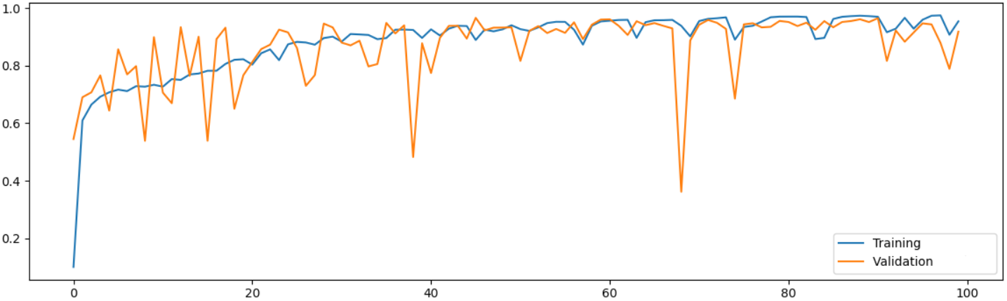
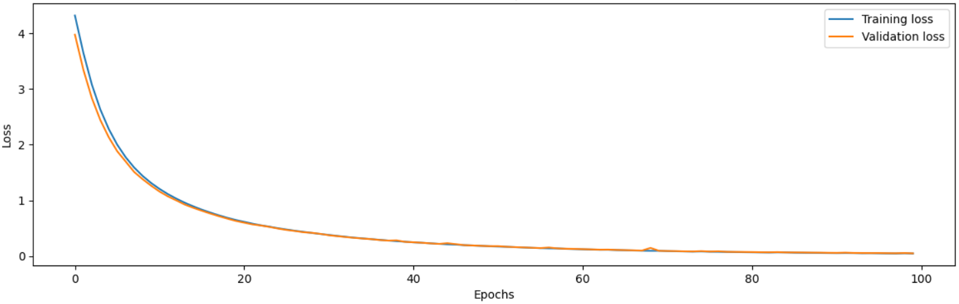
4. Experimental results
Training results
Fig 11a. The chart compares the accuracy and loss of Sce.1.

Slide 21
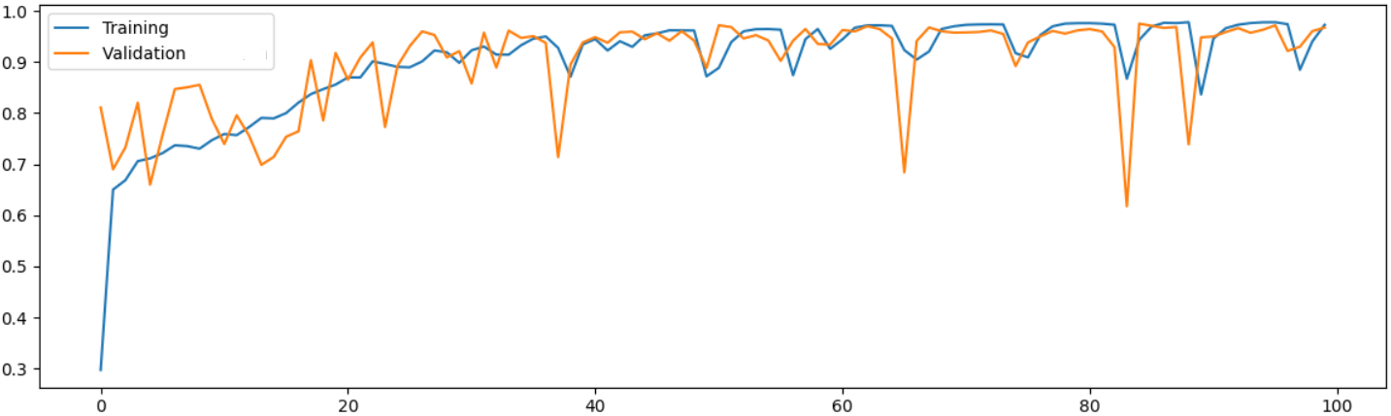

4. Experimental results
Training results
Fig 11b. The chart compares the accuracy and loss of Sce.2.

Slide 22
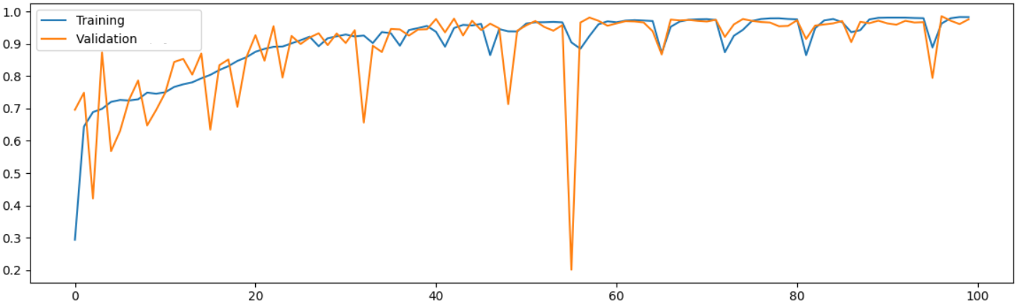

4. Experimental results
Training results
Fig 11c. The chart compares the accuracy and loss of Sce.3.

Slide 23
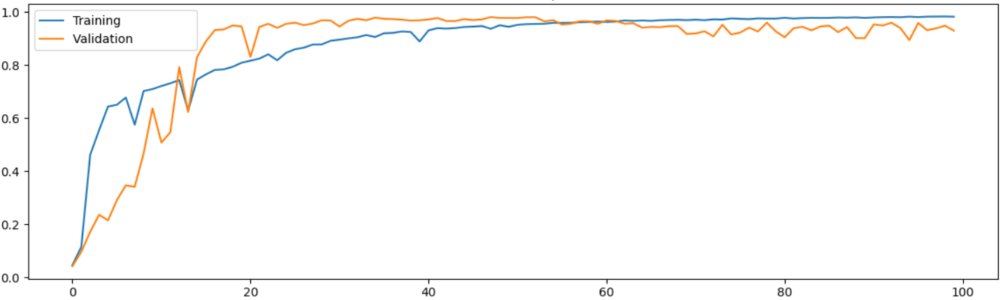
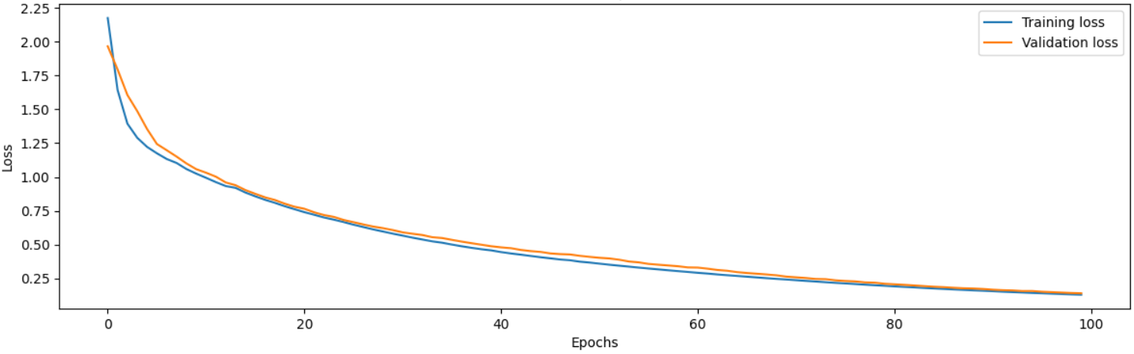
4. Experimental results
Training results
Fig 11d. The chart compares the accuracy and loss of Sce.4.

Slide 24
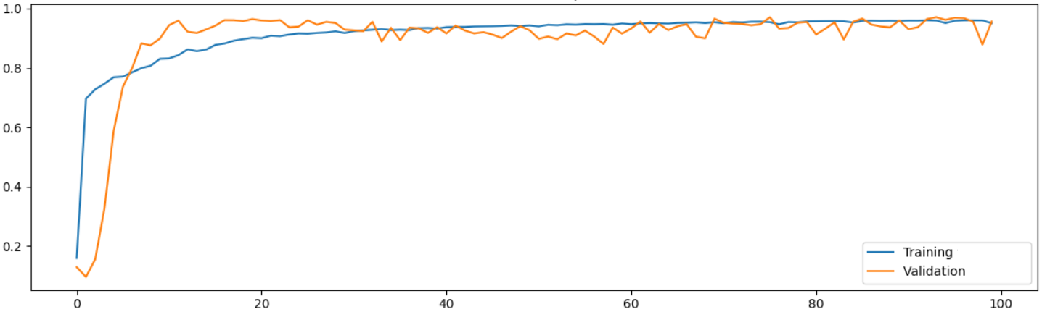
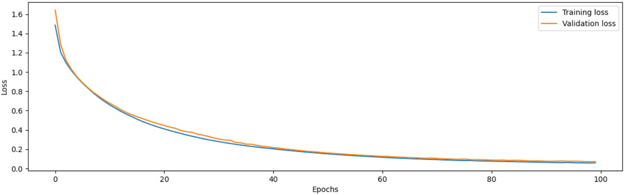
4. Experimental results
Training results
Fig 11e. The chart compares the accuracy and loss of Sce.5.

Slide 25
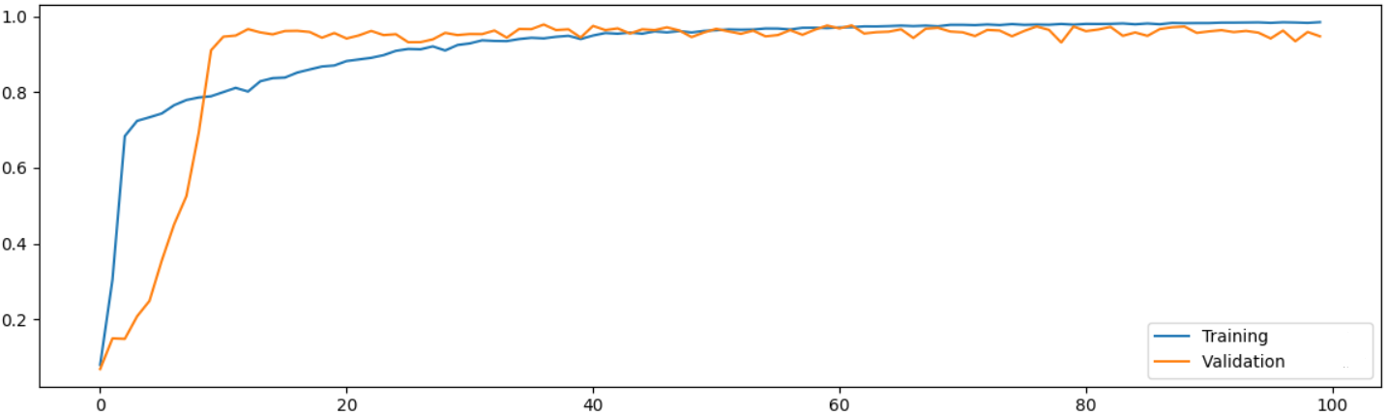
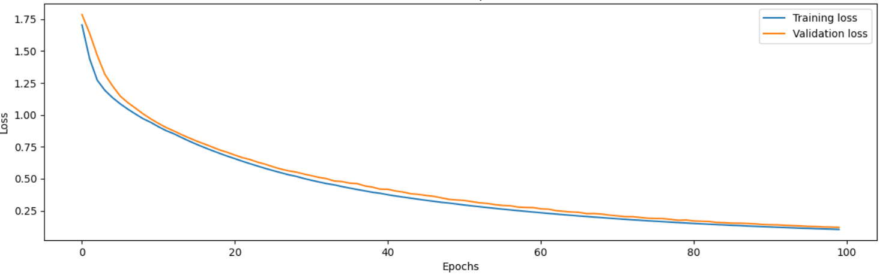
4. Experimental results
Training results
Fig 11f. The chart compares the accuracy and loss of Sce.6.

Slide 26
4. Experimental results
Table 2: Confidence on the dataset after applying JRIP and PART algorithm
Sce. | Algorithm | Acc | Precision | Recall | F1-score
1 | U-Net JRIP | 98.66 | 98.60 | 98.53 | 98.57
2 | U-Net PART | 96.74 | 96.14 | 96.08 | 96.11
3 | DeepLabv3+ JRIP | 94.83 | 94.09 | 94.03 | 94.06
4 | DeepLabv3+ PART | 91.96 | 91.35 | 91.60 | 91.46

Slide 27
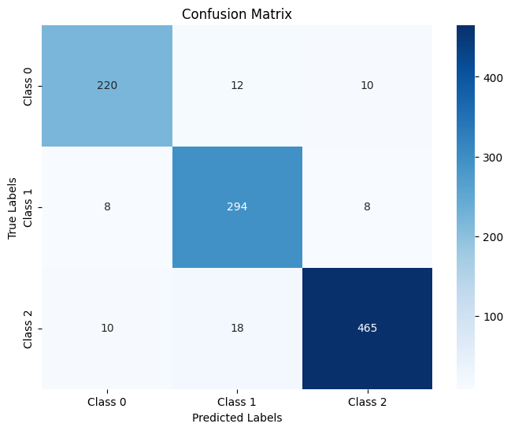


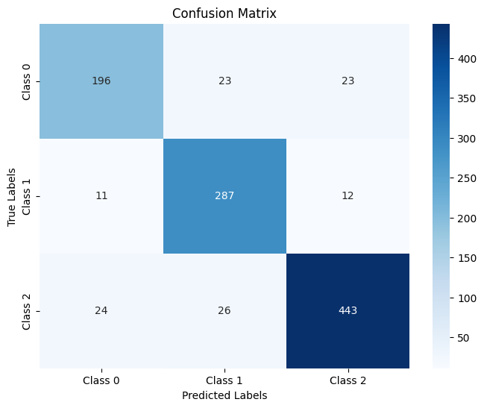
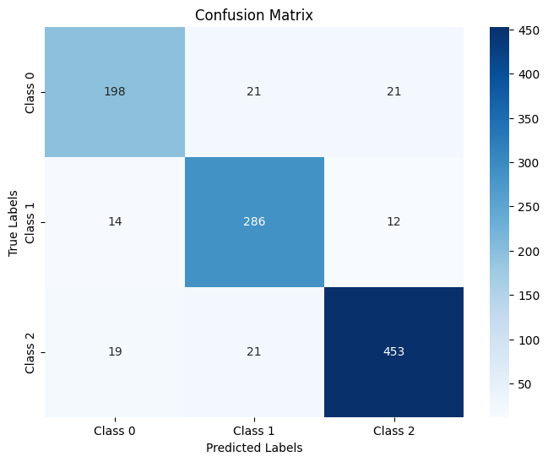

4. Experimental results
Sce.1 Sce.2 Sce.3
Sce.4 Sce.5 Sce.6
Fig 12. Confusion matrix of 6 scenarios

Slide 28
4. Experimental results
Tab 3. Evaluation results on test dataset
Scenario | Class | Precision(%) | Recall(%) | F1-Score(%) | mAP(%) | IoU
1 | Benign | 92.44 | 90.91 | 91.67 | 93.68 | 0.875
 | Malignant | 90.74 | 94.84 | 92.74
 | Normal | 96.27 | 94.32 | 95.29
2 | Benign | 92.59 | 92.98 | 92.78 | 94.64 | 0.899
 | Malignant | 93.04 | 94.84 | 93.93
 | Normal | 96.71 | 95.33 | 96.02
3 | Benign | 88.31 | 90.50 | 89.39 | 92.25 | 0.857
 | Malignant | 89.91 | 91.94 | 90.91
 | Normal | 95.83 | 93.31 | 94.55
4 | Benign | 84.85 | 80.99 | 82.88 | 88.61 | 0.796
 | Malignant | 85.42 | 92.58 | 88.85
 | Normal | 92.68 | 89.86 | 91.25
5 | Benign | 85.71 | 82.50 | 84.08 | 89.66 | 0.813
 | Malignant | 87.20 | 91.67 | 89.38
 | Normal | 93.21 | 91.89 | 92.54
6 | Benign | 84.98 | 81.82 | 83.37 | 88.90 | 0.800
 | Malignant | 85.67 | 92.58 | 88.99
 | Normal | 93.08 | 90.06 | 91.55

Slide 29
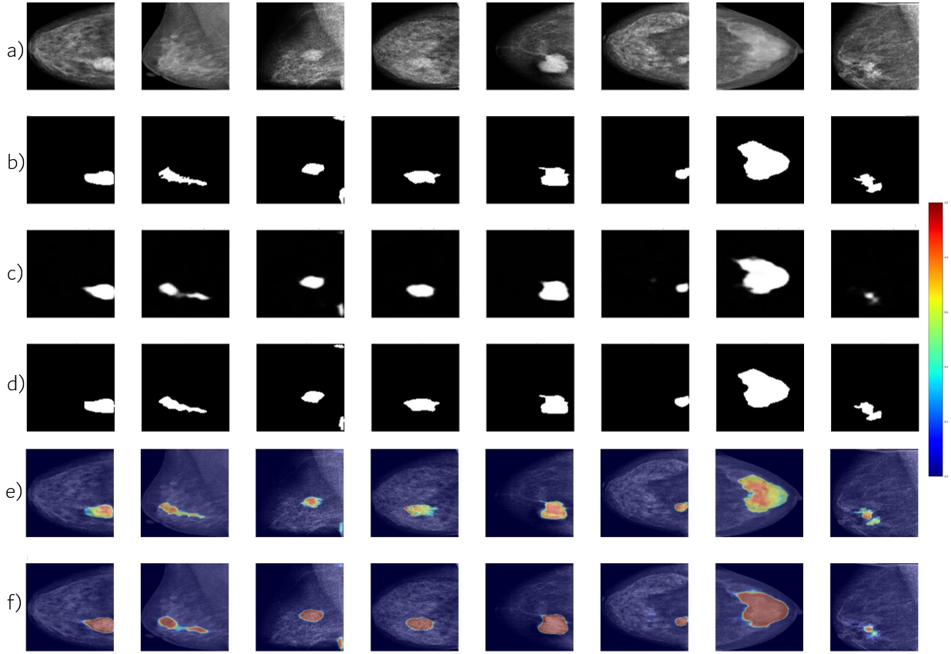
Fig 13. The classification results on the test set a) Original image, b) Ground truth mask, c) Mask of DeepLabv3+ model, d) Mask of U-Net model, e) U-Net Grad-CAM, f) DeepLabv3+ Grad-CAM

Slide 30
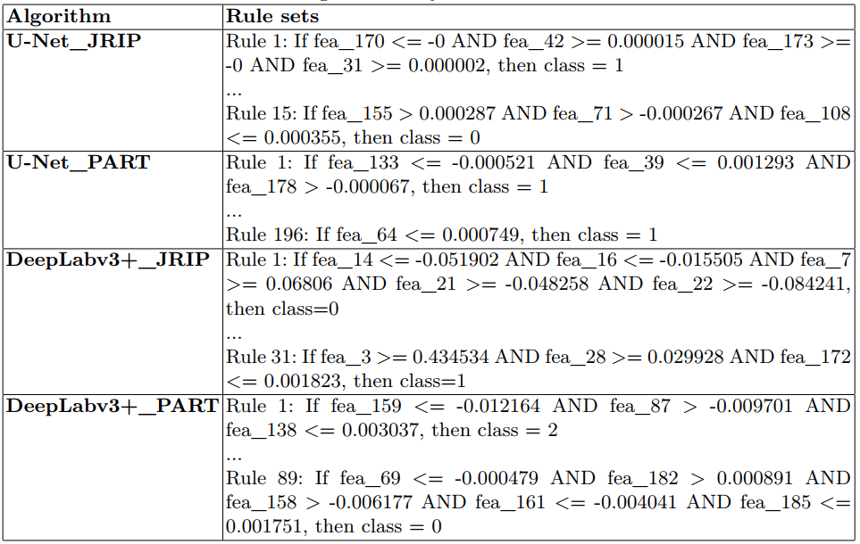
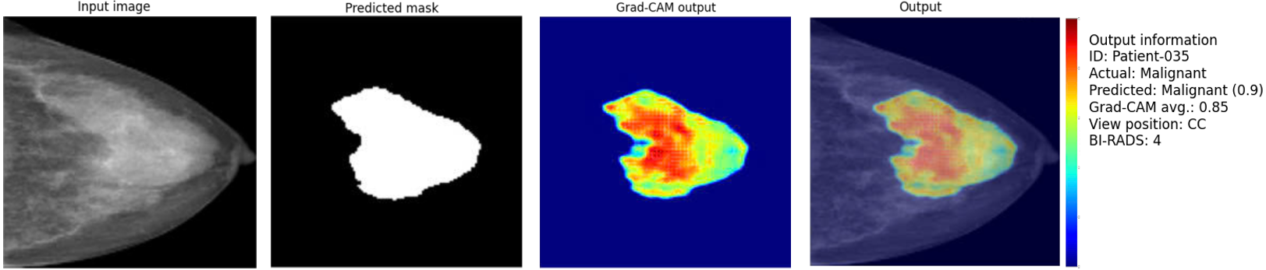
4. Experimental results
Fig 14. Rule sets generated by the trained models
Fig 15. Results on input image of the proposed model

Slide 31
5. Conclusion
we propose a multi-task model for detecting, classifying, and segmenting breast cancer based on rule sets and XAI.
we combine the fuzzy inference system with the Grad-Cam technique to display the importance of the detected mass region, thereby improving the efficiency of explaining the output of the proposed method.
U-Net_JRIP combination model achieves the highest accuracy of 94.64% with IoU 0.899.
In future work, we will compare and improve the rule generation models and incorporate additional features such as microcalcifications and density in the images to improve the model accuracy.

Slide 32
References
[1] W. H. Organization, WHO guidelines for screening and treatment of precancerous lesions for cervical cancer prevention. World Health Organization, 2021.
[2] Chong, Alice, et al. "Digital breast tomosynthesis: concepts and clinical practice.“ Radiology 292.1 (2019): 1-14.
[3] Chowdhary, Chiranji Lal, et al. "Past, present and future of gene feature selection for breast cancer classificationa survey." International Journal of Engineering Systems Modelling and Simulation 13.2 (2022): 140-153.
[4] Clancy, Kadie, et al. "Deep learning pre-training strategy for mammogram image classification: an evaluation study." Journal of Digital Imaging 33 (2020): 1257-1265.
[5] Apoorva, V., H. K. Yogish, and M. L. Chayadevi. "Breast cancer prediction using machine learning techniques." 3rd International Conference on Integrated Intelligent Computing Communication & Security (ICIIC 2021). Atlantis Press, 2021.
[6] Prodan, Marcel, Elena Paraschiv, and Alexandru Stanciu. "Applying deep learning methods for mammography analysis and breast cancer detection." Applied Sciences 13.7 (2023): 4272.
[7] Arora, Shaveta, and Amanpreet Kaur. "Modified edge detection technique using fuzzy inference system." International Journal of Computer Applications 44.22 (2012): 9-1.

Slide 33

THANK YOU FOR
YOUR ATTENTION !!!

